Slide 1


Case Study 2 DDS
Predictive Analytics
Donald Anderson

Slide 2
Executive Summary
Challenge
Talent management is defined as the iterative process of developing and retaining employees. It may include workforce planning, employee training programs, identifying high-potential employees and reducing/preventing voluntary employee turnover (attrition). In order to gain a competitive edge over its competition, the CEO and CFO of Frito Lay is planning to leverage data science for talent management. Frito Lays’ leadership team has determined that predicting employee turnover will be its first application of data science for talent management.
Solution
DDS Analytics specializes in talent management solutions for Fortune 100 companies. Their client, Frito Lay has provided the analytics company with a dataset to conduct data analysis that will identify factors that lead to attrition. DDS Analytics will present the executive staff with evidence-based analysis of the top three factors that contribute to employee turnover. Job-role specific trends that exist in the dataset will be shared in their findings as well as other interesting trends and observations from their research.

Slide 3
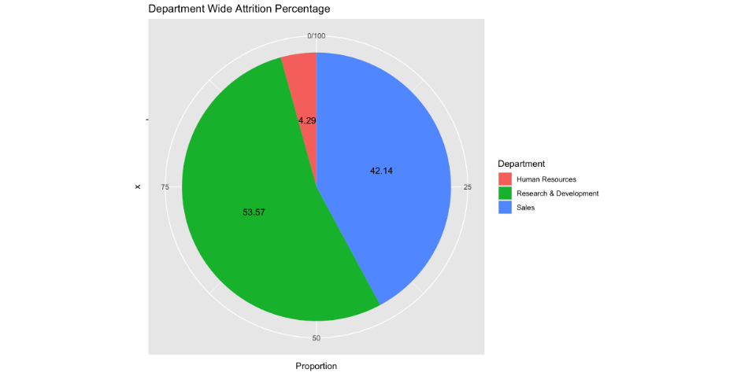
Attrition by Department

Slide 4
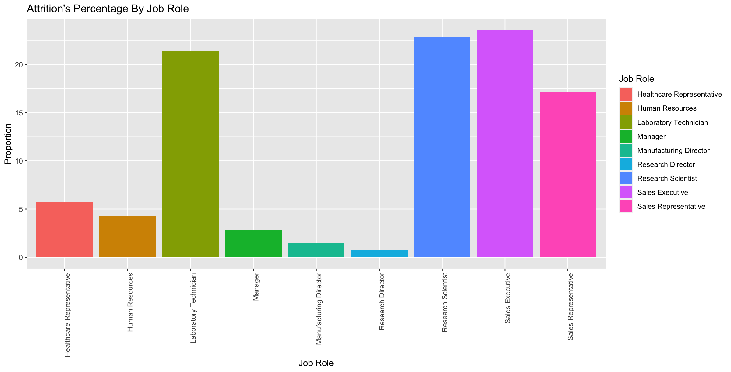
Attrition by Job Role

Slide 5
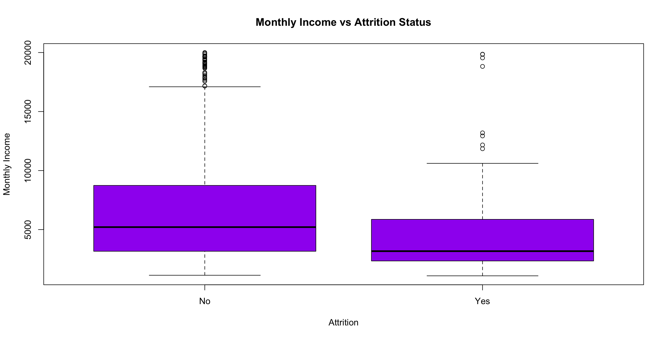
Attrition vs Monthly Income

Slide 6
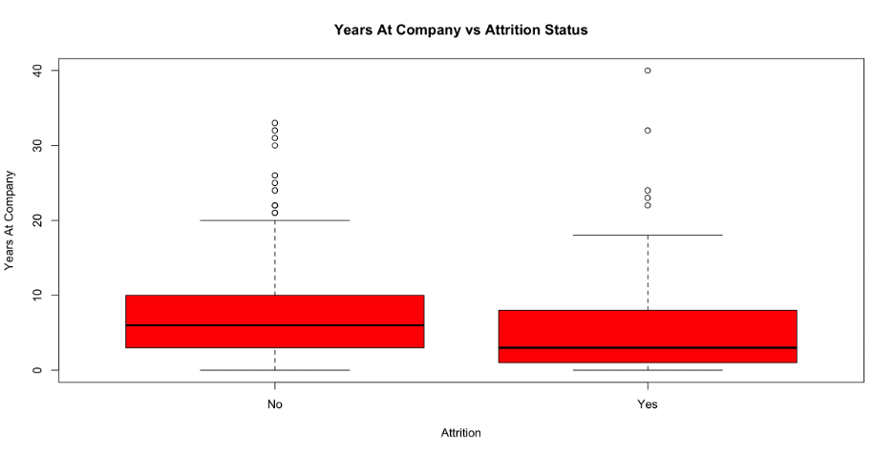
Attrition vs Years at Company

Slide 7
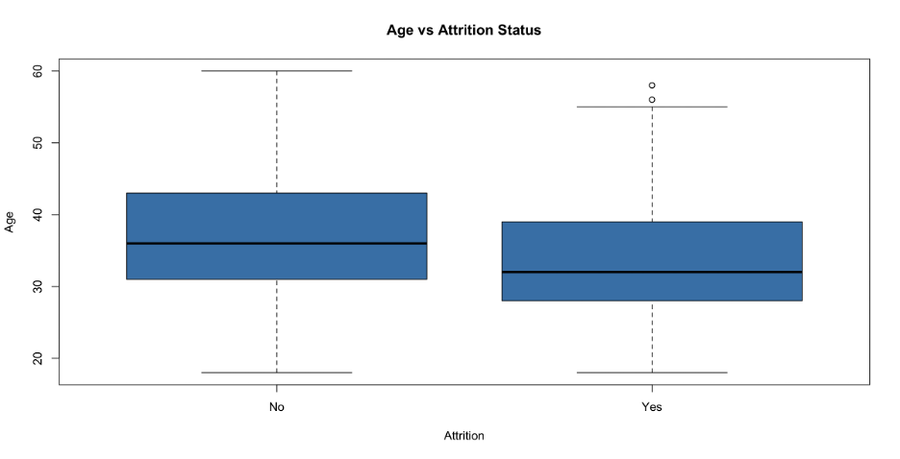
Attrition vs Age

Slide 8
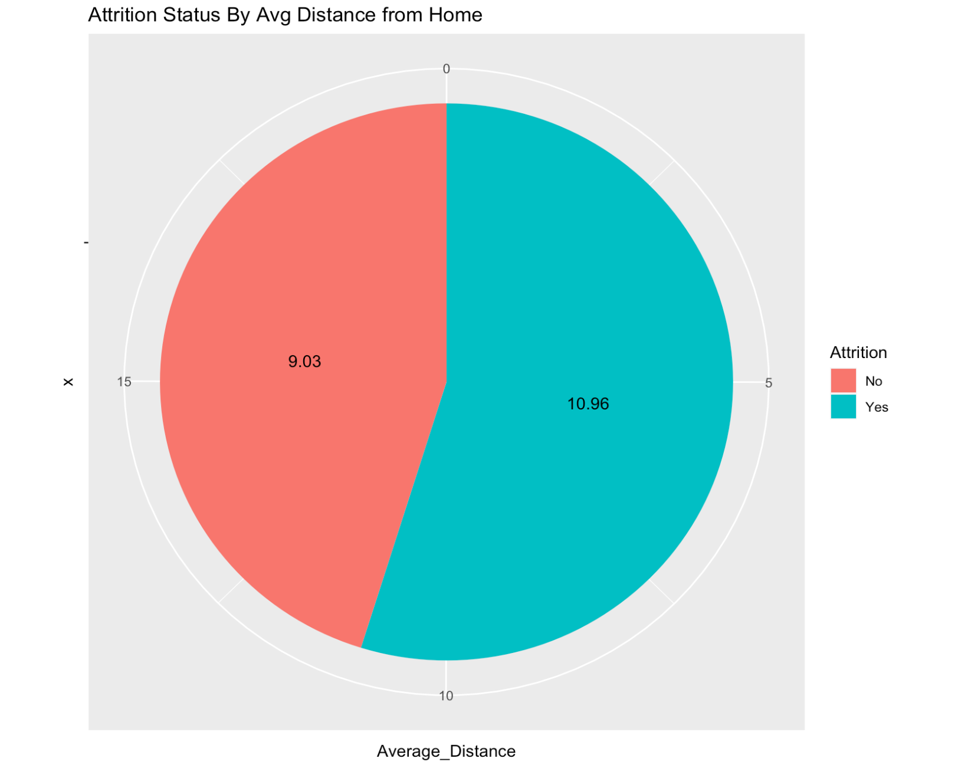
Attrition Status by Average Distance from Home
Employees whose homes are farthest away from the company location tend to have a higher attrition rate.
Whereas employees whose homes are closer to the company location have a lower attrition rate at 9%.

Slide 9

Salary Predictions
To determine the accuracy of my predictive model, real monthly incomes (salaries) must be used to assess my RMSE regression model.
I have provided a model that will attain a RMSE < $3000 for the training and the validation set.
My regression model has an RMSE of $1,146.49.
I have provided the predicted salaries (ordered by ID) in a csv file embedded here.

Slide 10
Attrition Predictions
The labels (ordered by ID) are provided in the embedded csv file.

Slide 11
Appendix
View Presentation on YouTube
Review EDA files here.

